Slide 1
Design of Secure Remote Diag on Container Separation Architecture
Candidate: Vu Hoang Phi (phi.vu)
Supervisor: Mr. Byung Yong Kim
LGEDV – August 2026

Slide 2
Table of contents
1
Overview
2
  Problem Identification
3
  Solution Proposals
4
  Design Proposals for Selected Solution
5
Implementation and Verification
6
Conclusion
6
7
Q&A

Slide 3
1. Overview - DCM and the RDG Module in Toyota 24LM
DCM simultaneously holding 2 conflicting security roles:
  Entry Point (EP): wirelessly communicates with TMC Center (HTTP/MQTT), SOME/IP, OTA - the largest attack surface on the vehicle.
  Internal diagnostic client: sends UDS requests to MCU and in-vehicle CAN bus.
Confirmed system-level solution: split DCM software into 2 partitions running Linux Containers (LXC): EP container and Internal Container
Remote Diag (RDG):
  Send diag commands to CAN
  High Fan-out: depends on ~12 services in EP (CommMgr, OBC, DiagMgr, PowerMgr, MQTTMgr, etc.)

Slide 4
1. Overview - DCM and the RDG Module in Toyota 24LM
DCM
MCU
Authorized Communication
EP Container
Internal Container
MCU Apps
Bidirectional Message Exchange
Message Reception
TMC Apps
Message Transmission
AUTOSAR
LGE Apps/Services
Remote Diag
InternalOnBoardClient
Filter
Internal CAN
OnBoardClient
Linux Kernel/Driver
SPI Rx
SPI Tx

Slide 5
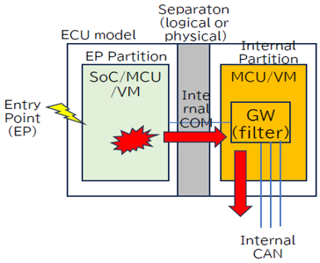
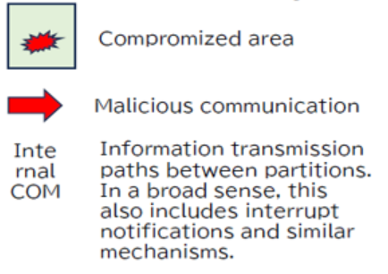
2. Problem identification
Context
  TMC’s Cybersecurity requirements
    When EP Partition is compromised, the damage must not propagate to Internal Partition and in-vehicle CAN bus.
    Unauthorized diagnostic commands related to reprogramming must be filtered.
Issues arising with RDG when separating partitions:
  Trust boundary vs functional dependency conflict: RDG belongs to the trusted zone but depends on ~12 modules in the EP — requires cross-trust-boundary communication without breaking isolation or causing IPC cost explosion.
  SID Filter placement: an attacker who compromises EP must not be able to disable the filter.

Slide 6
2. Problem identification – Key Quality Attributes
Quality Attribute | Priority | Description
Security | HIGH | Compromise contained within EP; EP impersonating DIAG client → discard; filter SID reprogramming (NFR-01/02/03)
Maintainability | MEDIUM | The new design should ensure that the system is able to support the changes in the future.
Simplicity | LOW | Balance implementation complexity with operational reliability for mission-critical systems.

Slide 7
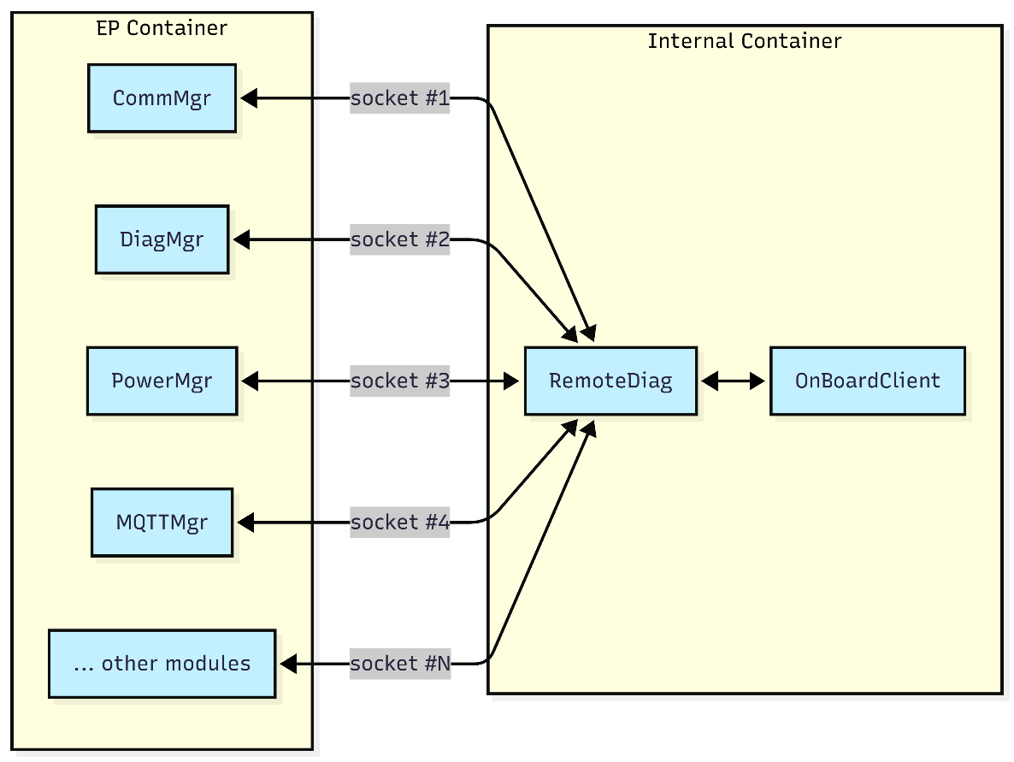
3. Solution proposals – Proposal A
Move the entire RDG module into IP container
For each dependency module in EP, define and implement an IPC socket for communication across containers.
✅ Advantages:
  Security: RDG fully within trusted zone.
❌ Disadvantages:
  Maintainability: ~12 EP modules must modify code and implement socket client - effort multiplied × N.
  Reliability: N socket channels = N separate fail-safe points required.

Slide 8
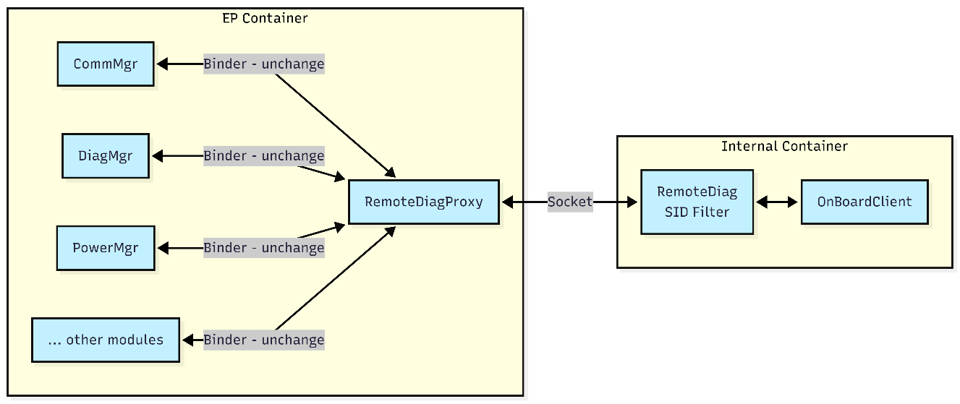
3. Solution proposals – Proposal B
Move the entire RDG module into IP container
Add RemoteDiagProxy (RDP) in EP acting as a transparent proxy – all EP modules treat RDP as the actual RDG itself.
Data flow is sent through one single Socket at the container edge.
✅ Advantages:
  Security: RDG + SID Filter fully in trusted zone.
  Maintainability: EP modules zero change – keep original Binder contract.
❌ Disadvantages:
  Reliability: RDP is a single point of failure (requires fail-safe).
  Performance: one additional socket hop per transaction (acceptable)..

Slide 9
3. Solution proposals – Comparison & Selection
Quality Attribute | Priority | Proposal A | Proposal B
Security | HIGH | ✓ RDG is fully in trusted zone | ✓ RDG is fully in trusted zone
Maintainability | MEDIUM | ✗ ~12 dependency modules must modify code | ✓ No change in the dependencies. Keep original Binder contract.
Simplicity | LOW | ✗ Effort x N | ✓ Reuse most of existing framework. Just develop socket communication between RDP and RDG

Slide 10
4. Design proposal for selected solution
TBD

Slide 11
4. Design proposal for selected solution
TBD

Slide 12
Q&A
Thank you for listening
Notes:
That’s all of my presentation
Thanks for listening. Please let me know if you have any questions

Slide 13
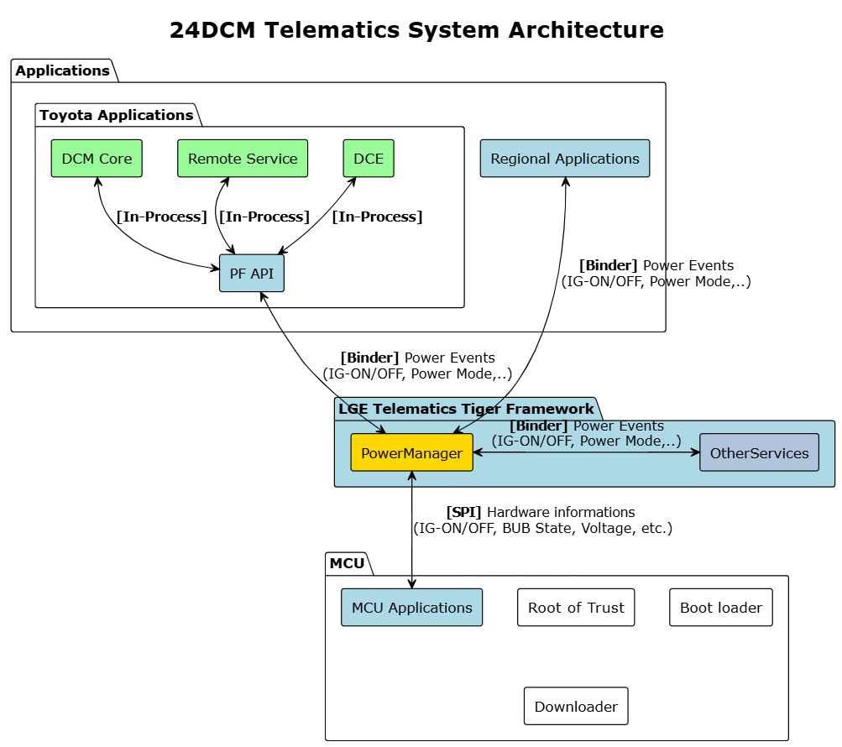
1. Overview - DCM and the RDG Module in Toyota 24LM
Power Manager service is one of the services in the telematics system. It is responsible for collecting and managing power-related information from various modules, and actively notifies other applications and services about changes in power state, power source, and battery status…
Power Manager service’s characteristics :
High Fan-out: ~38 service receivers in 24DCM project.
Sequential Processing: Events must be processed in order.
High Reliability Required: Failures or delays in event notification can cause battery drain and system-wide issues.
More details at Appendix 1

Slide 14
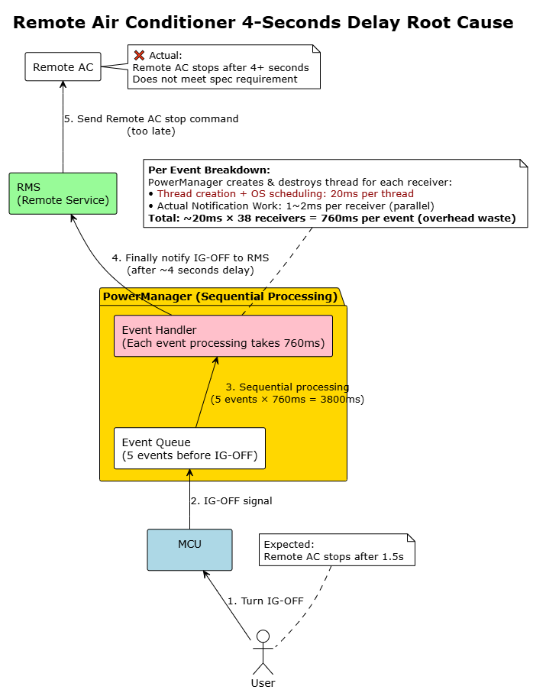
2. Problem Identification
Starting point: issue DCM24MON-4575
Scenario: User turns off Ignition (IG)
Expected: Remote Air Conditioner stops after 1.5s
Actual: Remote Air Conditioner takes 4s to respond
Cause: The IG off status is delayed 4 seconds in Power Manager before notified to Remote Service.
Target for improvement
Delayed notifications are primarily a performance issue, but when they lead to functional errors, they also compromise system reliability, especially during critical power transitions.
→ Improving the power notification mechanism is essential for both performance and system reliability.
More details at Appendix 5, 6, 7

Slide 15
2. Problem Identification
Key quality attributes while improving:
Quality Attribute | Priority | Description
Performance | High | System must meet timing requirements for critical operations with consistent response times. (From 760ms to under 250ms for 1 event → total time for 6 notifies < 1.5 seconds)
Reliability | High | Ensure all services/apps receive notifications even when other services/apps fail.
Resource Efficiency | Medium | Efficiently manage resources since power notifications occur infrequently, avoiding waste while ensuring rapid response when needed.
Maintainability | Medium | The new design must ensure that the system is able to support the changes in the future.
Reusability | Medium | New design would be beneficial if it can be reused for other services since all services utilize this notification mechanism
Simplicity | Low | Balance implementation complexity with operational reliability for mission-critical systems.

Slide 16
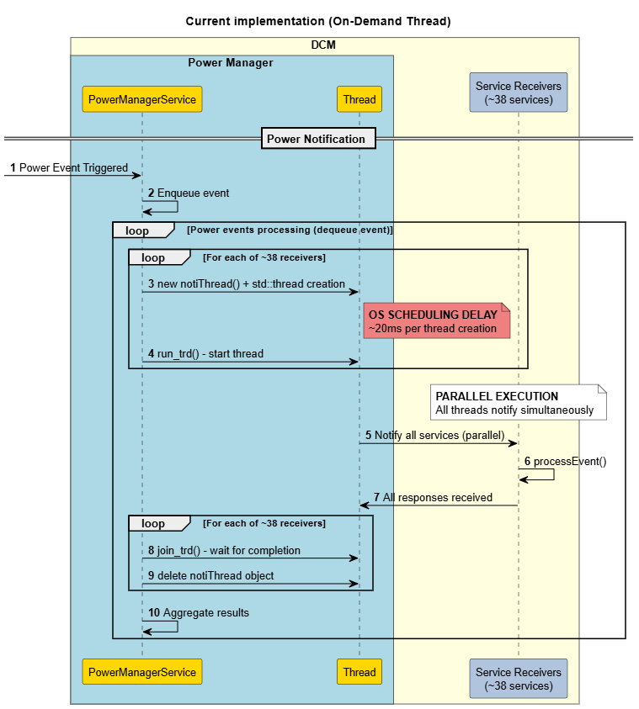
2. Problem Identification
Current implementation (On-Demand Thread)
Create a new thread for each notification task, then destroy it immediately after completion.
✅ Advantages:
  Reliability: High reliability - each receiver has dedicated thread, guarantees all receivers get notifications.
  Simplicity: Straightforward implementation.
  Resource Efficiency: No permanent threads when idle.
❌ Disadvantage:
    Performance: Extremely poor due to OS scheduling overhead.

Slide 17
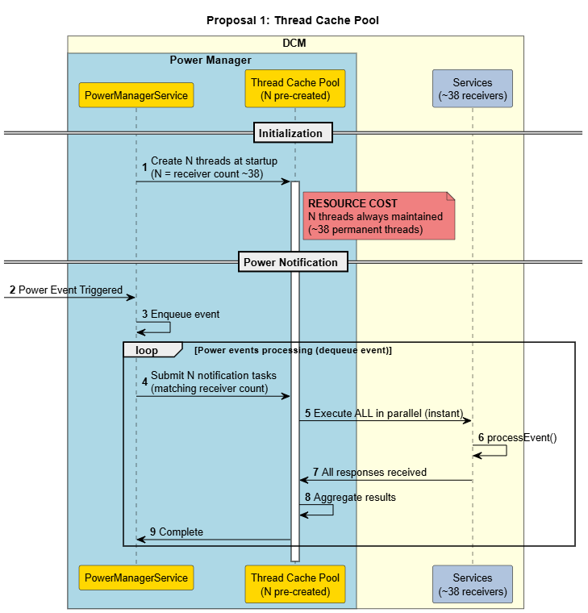
3. Solution Proposals
Proposal 1 - Thread Cache Pool
Pre-create threads matching receiver count (~38), keep them alive permanently for instant response.
✅ Advantages:
  Performance: Zero thread creation delay, instant response (estimated <10ms)
  Reliability: Threads always available, ensures all receivers always receive notifications immediately.
  Simplicity: Straightforward implementation, minimal code changes required.
❌ Disadvantage:
  Resource Efficiency:
  - Significant memory waste, threads remain idle most of the time.
  - CPU usage spikes during notification.

Slide 18
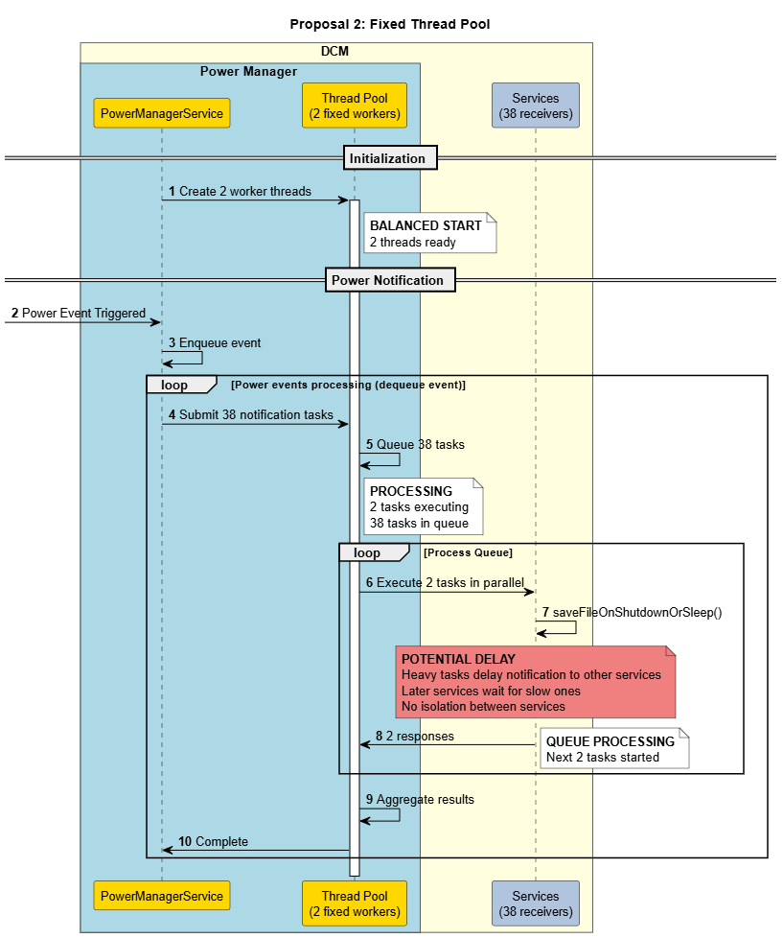
3. Solution Proposals
Proposal 2 - Fixed Thread Pool
Use a fixed thread pool (e.g., 2 permanent threads) to handle all notifications
✅ Advantages:
  Performance: High (estimated ~20ms for 40 receives with 2 threads)
  Resource Efficiency: Maintain only a fixed number of permanent threads.
❌ Disadvantages:
  Reliability: When all threads delay, other receivers are delayed due to thread delays.
  Simplicity: Moderate implementation complexity.

Slide 19
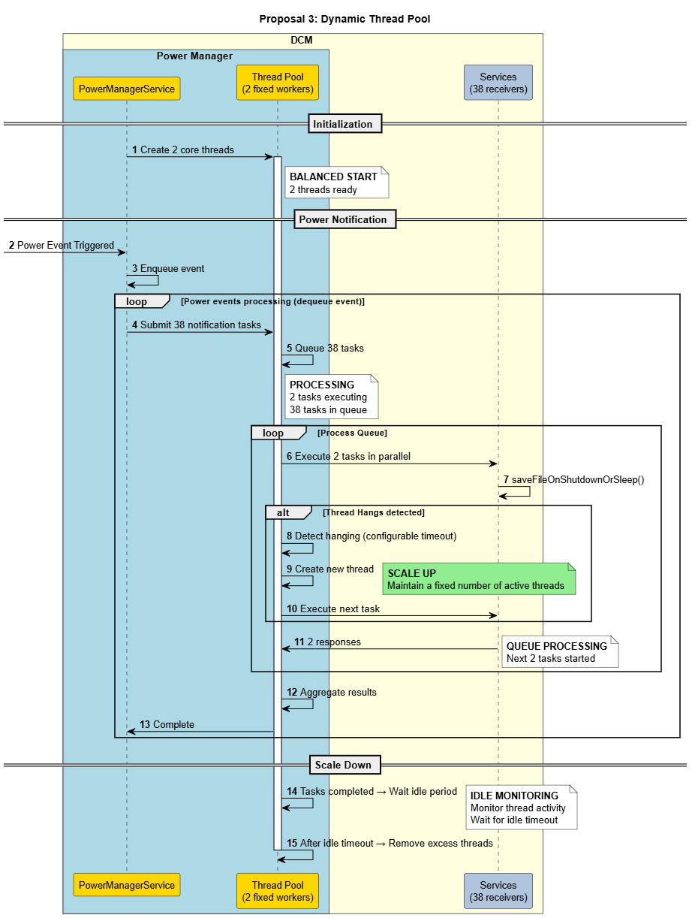
3. Solution Proposals
Proposal 3 - Dynamic Thread Pool
Start with a fixed number of threads (e.g., 2 threads) as baseline thread pool.
Scale up: Auto-create additional threads when individual thread processing time exceeds threshold.
Scale down: Automatically reduce thread count to baseline after a certain period of inactivity to optimize resource usage.
✅ Advantages:
  Performance: High (estimated ~20ms for 40 receives with 2 threads)
  Reliability: Self-healing with automatic delay thread replacement
  Resource Efficiency: Adaptive memory usage based on actual demand
❌ Disadvantage:
  Simplicity: Higher implementation complexity with scale algorithm.

Slide 20
3. Solution Proposals
Criteria | Priority | On-Demand Thread (Current implementation) | Thread Cache (Proposal 1) | Fixed Pool (Proposal 2) | Dynamic Thread Pool (Proposal 3)
Performance | High | Low (~800ms) | High (<10ms) | High (~20ms) | High (~20ms)
Reliability | High | High | High | Low (Delay/fail risk) | High (Auto-scale when delay)
Resource Efficiency | Medium | Medium Clear threads when idle High CPU when notify | Low Keep lots of threads when idle High CPU when notify | Medium | Medium
Simplicity | Low | High | High | Medium | Low
Key Decision Factors:
Performance vs. Resource: Dynamic Pool fast enough (~20ms for 40 receives with 2 core threads), Thread Cache resource waste unacceptable for long-running system.
Simplicity: Complex implementation acceptable due to Power Manager's mission-critical nature where reliability outweighs simplicity.
Balanced Trade-offs: Good performance + reliability + adaptive efficiency outweigh complexity concerns.
🏆 Selected proposal 3: Dynamic Thread Pool

Slide 21
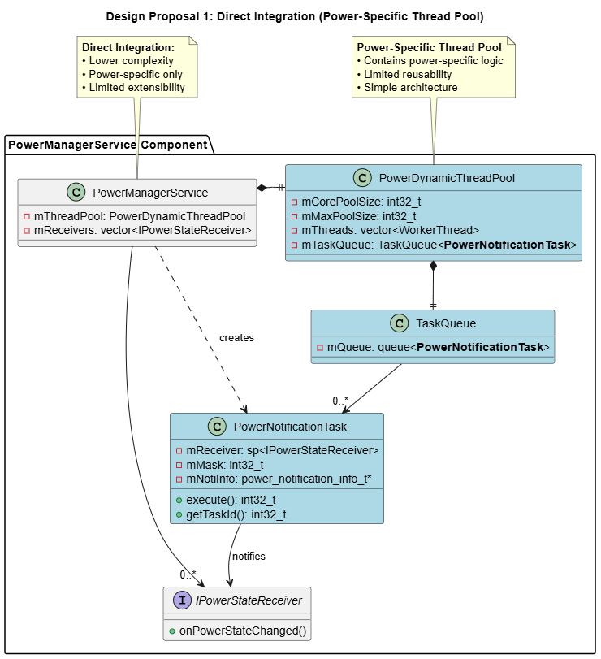
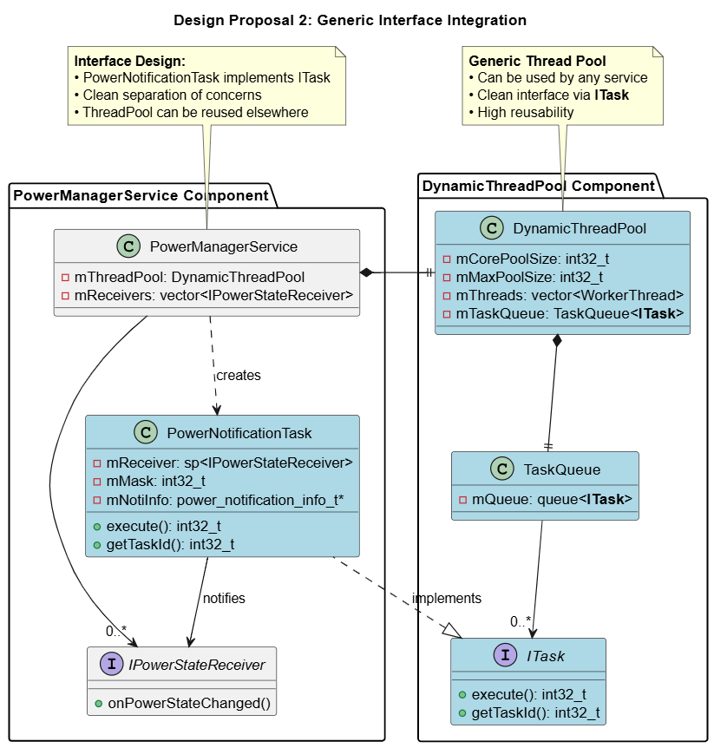
4. Design Proposals for Selected Solution
Legend
New components
Existing components
Proposal 1: Direct Integration (Power-Specific Thread Pool)
Proposal 2: Generic Interface Integration

Slide 22
4. Design Proposals for Selected Solution
Criteria | Priority | Direct Integration (Proposal 1) | Generic Interface Integration (Proposal 2)
Maintainability | Medium | Low (mixed concerns) | High (separated concerns)
Reusability | Medium | Low (power-specific only) | High (works across services)
Simplicity | Low | High (simple integration) | Medium
Key Decision Factors:
Reusability: Enable thread pool usage across multiple services
Clean Architecture: Separation of concerns for better maintainability
Trade-off: Slightly higher complexity for significantly better long-term value
🏆 Selected Design: Generic Interface Integration (Proposal 2)

Slide 23

5. Implementation and Verification
DCM24MON-4575 test results
Configuration: 2 core threads.
Log explanation:
Ignition OFF: “IGN-OFF”
Remote Service received IG OFF status: “State = 2 RAC_remoteAcCallback.c racChangeIgnitionCb”
On-Demand Thread
4.2 seconds
Dynamic Thread Pool
140 mili-seconds

Slide 24
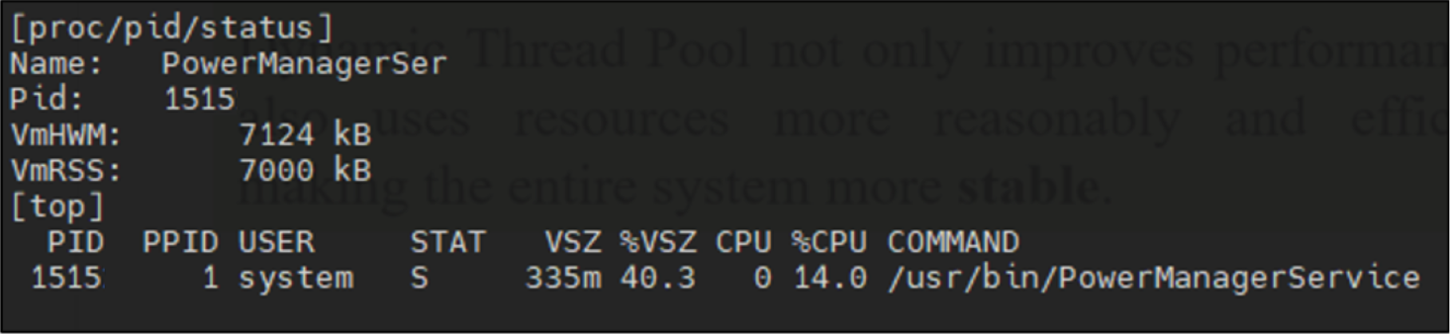
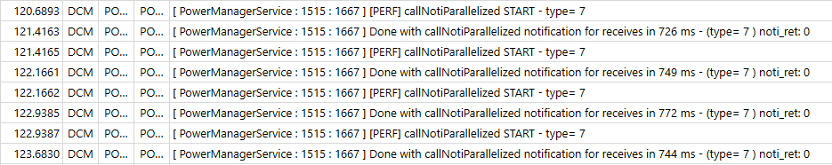
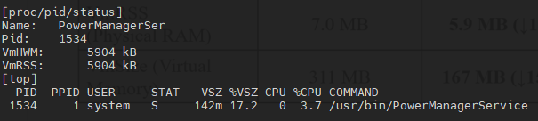
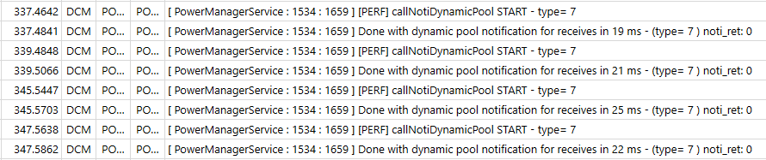
5. Implementation and Verification
On-Demand Thread
System Resource Verification
Criteria | On-Demand Thread | Dynamic Thread Pool
Notification time (for an event) | 750 ms | 22 ms (↓97%)
CPU utilization (during notifications) | 14% | 3.7% (↓74%)
VmRSS (Physical RAM) | 6.8 MB | 5.7 MB (↓12%)
VmSize (Virtual Memory) | 335 MB | 142 MB (↓58%)
Dynamic Thread Pool
Dynamic Thread Pool not only improves performance but also uses resources more reasonably and efficiently, making the entire system more stable.

Slide 25
6. Conclusion
Quality Attribute | Priority | Description | Result
Performance | High | Improved notification processing to ~22ms per event. | ✅
Reliability | High | Implemented fail-safe mechanism to prevent one service from affecting other services during notification processing. | ✅
Resource Efficiency | Medium | Resource optimization mechanism when not in use in idle time. | ✅
Maintainability | Medium | New design is modular and independent, making it easy to maintain. | ✅
Reusability | Medium | New design can be reused for notification tasks or other operations requiring multi-threading capabilities. | ✅
Simplicity | Low | New implementation is relatively complex but acceptable. | ❌
Plan to apply:
November 2025:
  Apply the Dynamic Thread Pool to the Power Manager Service (Core part) in the Toyota 24DCM (SU) project.
  Apply the Dynamic Thread Pool for 26BEV project
May 2026:
  Apply the solution to Power Manager Service of all projects.
  Move the Dynamic Thread Pool source code to the Tiger Framework Until to enable usage by other services.

Slide 26
Q&A
Thank you for listening
Notes:
That’s all of my presentation
Thanks for listening. Please let me know if you have any questions

Slide 27
DCM
MCU
EP Container
Internal Container
MCU Apps
TMC Apps
AUTOSAR
LGE Apps/Services
Other
Remote Diag
OBC
Internal CAN
Linux Kernel/Driver
SPI Rx
SPI Tx

Slide 28
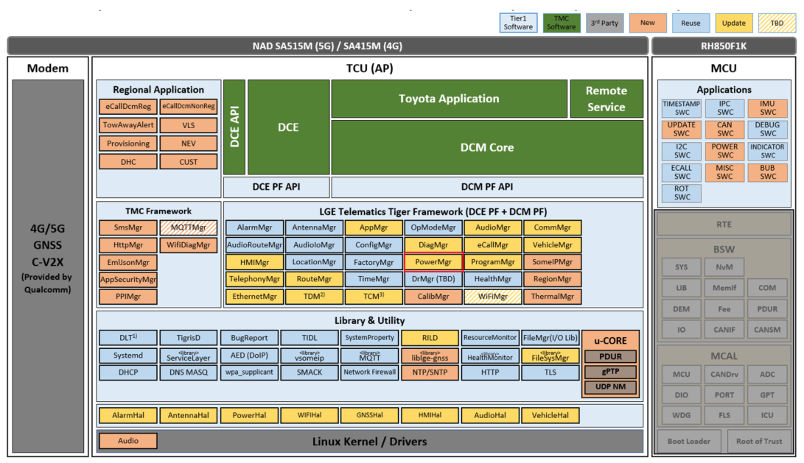
Appendix 1

Slide 29
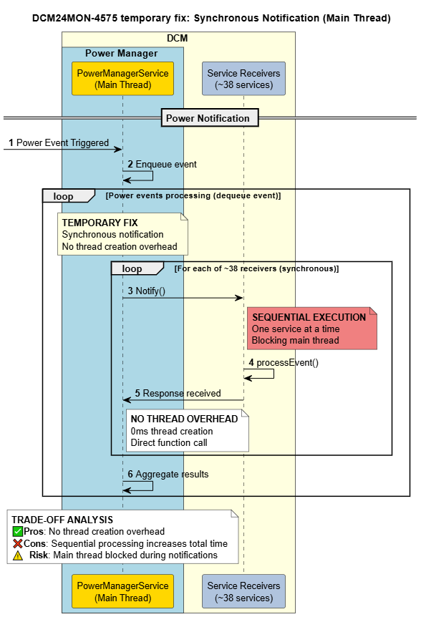
Appendix 2

Slide 30
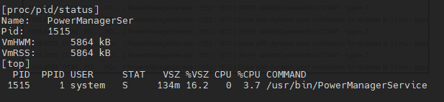
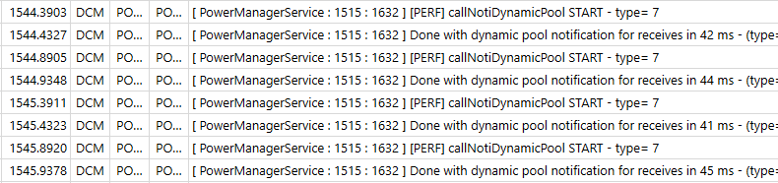
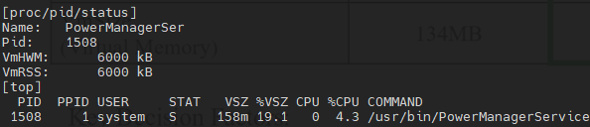
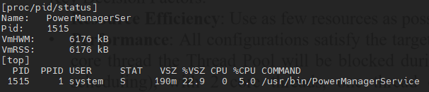
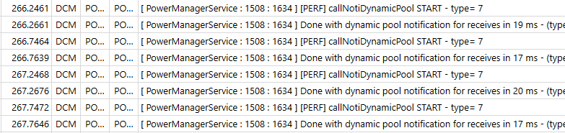
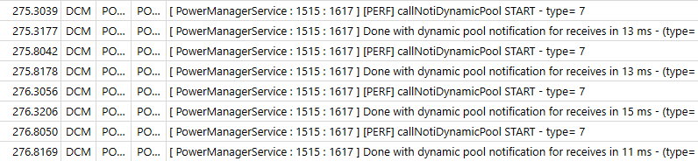
Appendix 3 - Configuration
Dynamic Thread Pool – 1 core thread
Dynamic Thread Pool – 2 core threads
Dynamic Thread Pool – 4 core threads
Dynamic Thread Pool – 8 core threads

Slide 31
Appendix 4 - Configuration
Criteria | 1 core thread | 2 core threads | 4 core threads | 8 core threads
Notification time (for an event) | 42ms | 22ms | 19ms | 13ms
CPU utilization (during notifications) | 3.7% | 3.7% | 4.3% | 5.0%
VmRSS (Physical RAM) | 5.72 MB | 5.76MB | 5.86MB | 6.03 MB
VmSize (Virtual Memory) | 134MB | 142 MB | 158 MB | 190 MB
More details at Appendix 3
Key Decision Factors:
Resource Efficiency: Use as few resources as possible to keep the system stable.
Performance: All configurations satisfy the target of less than 250ms. However, if a hang occurs, with 1 core thread the Thread Pool will be blocked during hang recovery (~20ms for new thread creation and scheduling), with 2 core threads, one thread continues working while the other thread recovers, minimizing blocking time in notification processing.
→ 2 core threads provides the optimal balance between risk mitigation, resource efficiency, and performance.

Slide 32
Appendix 5 - Configuration
Hanging threshold (Scale up threshold)
Measurement Result: Most services process notifications within 10ms under normal conditions.
Reason: The 500ms threshold balances thread creation overhead with response time - avoiding excessive overhead from too low values (100ms) while preventing notification delays from too high values (1000ms), providing sufficient buffer for both normal operations and heavy tasks like file saves during sleep/reset sequences.
→ Selected Value: 500ms threshold
Keep alive time (Scale down threshold)
Reason: 30 seconds based on automotive power event patterns where events occur in clusters followed by 30 seconds to several minutes of idle time. This duration balances thread availability for subsequent events against resource conservation, avoiding frequent creation/destruction cycles (10s too short) while preventing resource waste during extended idle periods (120s too long).
→ Selected Value: 30 seconds

Slide 33
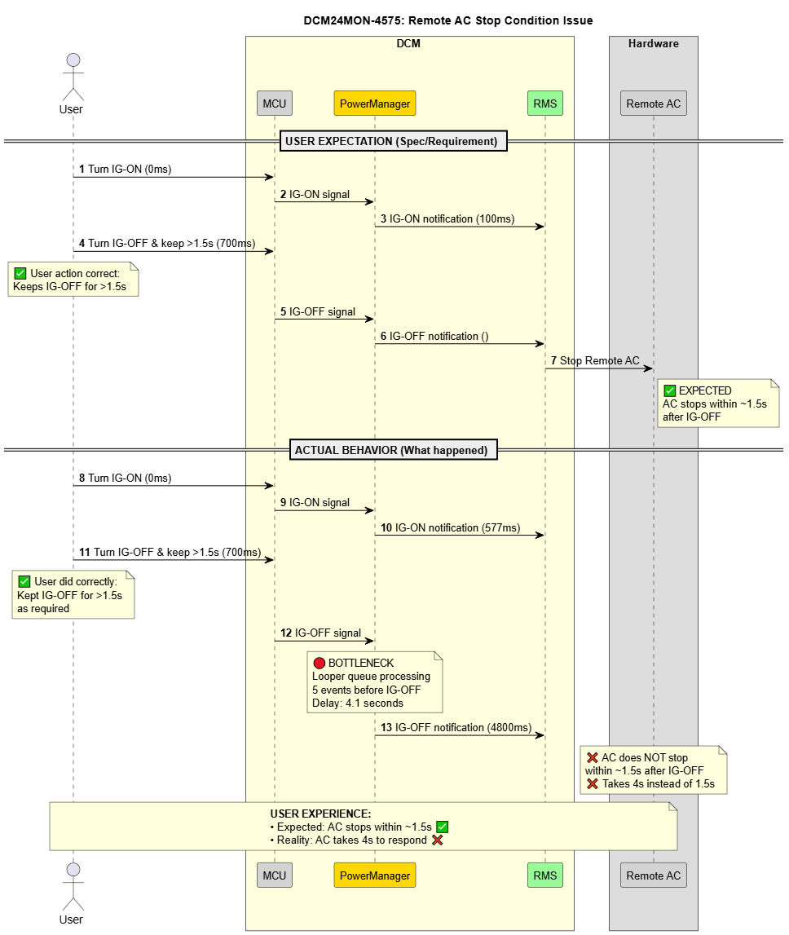
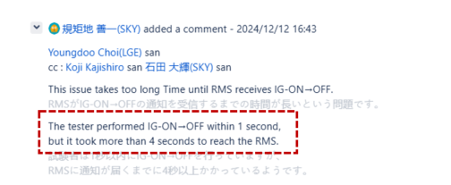
Appendix 6
Starting Point: issue DCM24MON-4575
Scenario: User turns off Ignition (IG)
Expected: AC stops within ~1.5s
Actual: AC takes 4s to respond
Cause: The IG off status is delayed 4 seconds in Power Manager before notified to Remote Service (AC controller)
Why does IG OFF status is delayed 4 seconds in Power Manager?

Slide 34
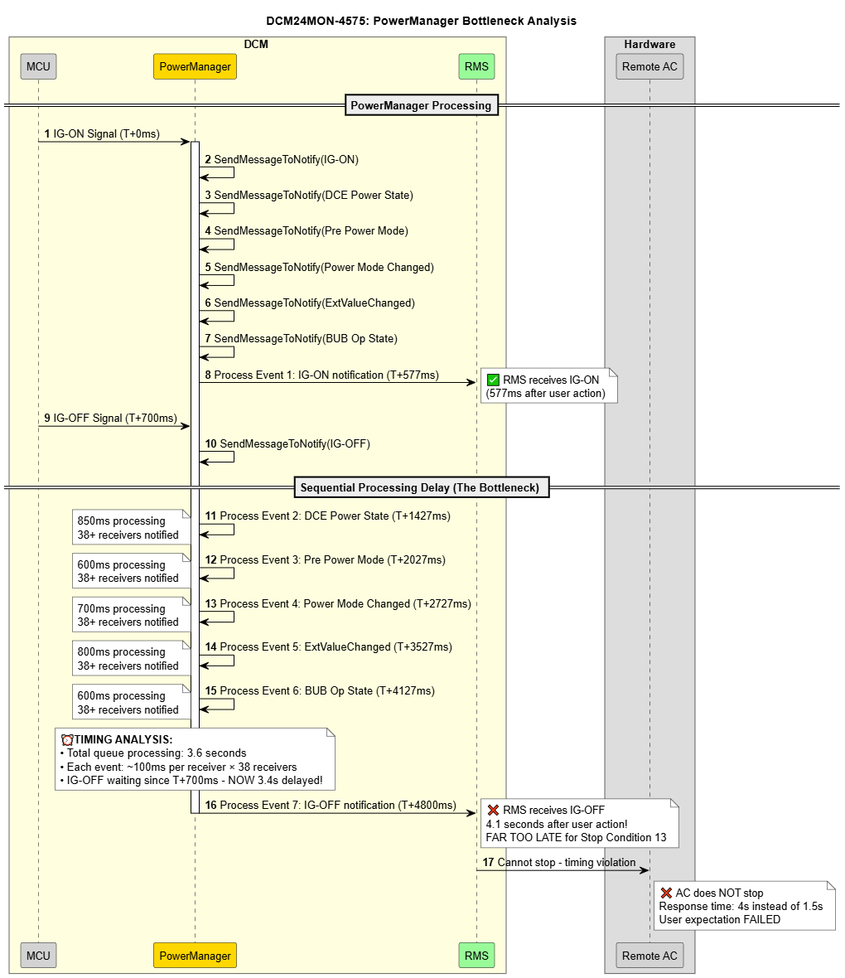
Appendix 7
Powerless Bottleneck:
• 38 receivers per event × 6 events = massive delay
• IG-OFF notification stuck behind other system events
Why does Power Manager take ~760ms per notify for ~38 receives?
4.1 seconds

Slide 35
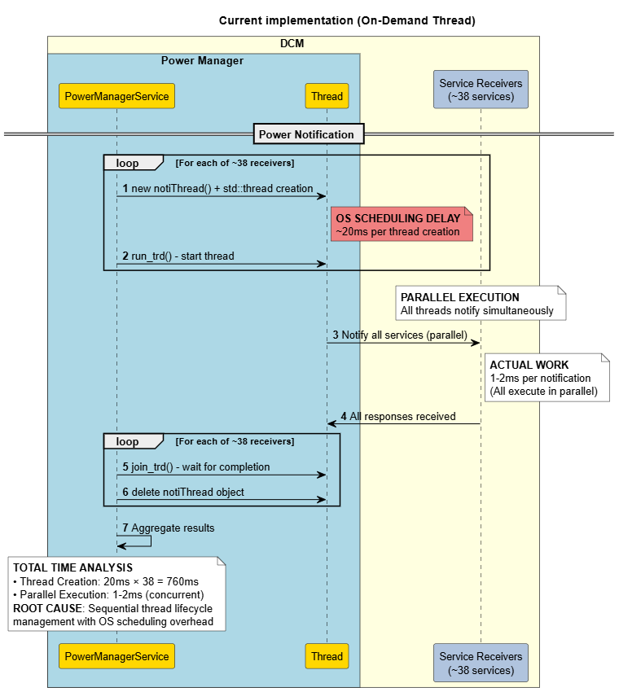
Appendix 8
Why does Power Manager take ~760ms per notify for ~38 receives?
Current Implementation : On-demand Thread Creation
Threads are created and destroyed dynamically for each receiver.
Thread creation: 30ms x 38 = 760ms
Actual notification: 1~2ms (parallel)
Total time: ~760ms
ROOT CAUSE: Sequential thread lifecycle management with OS scheduling overhead

Slide 36
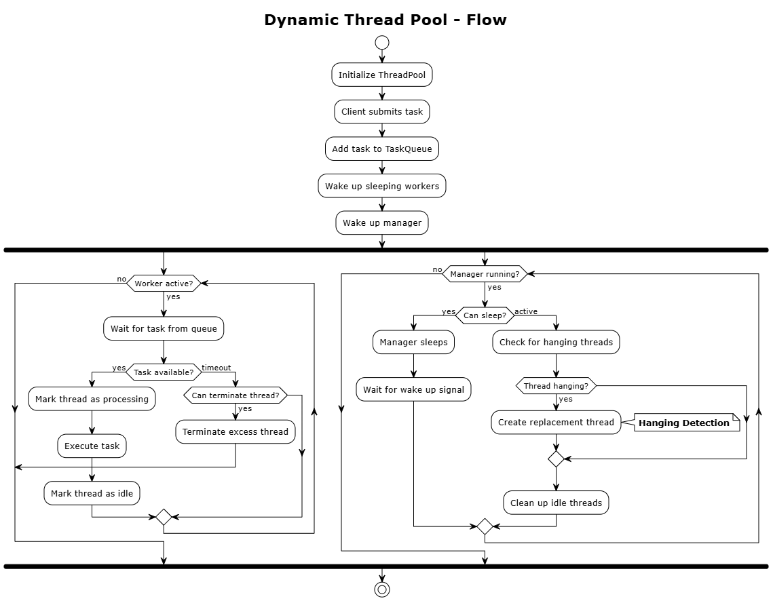
Appendix 9

Slide 37
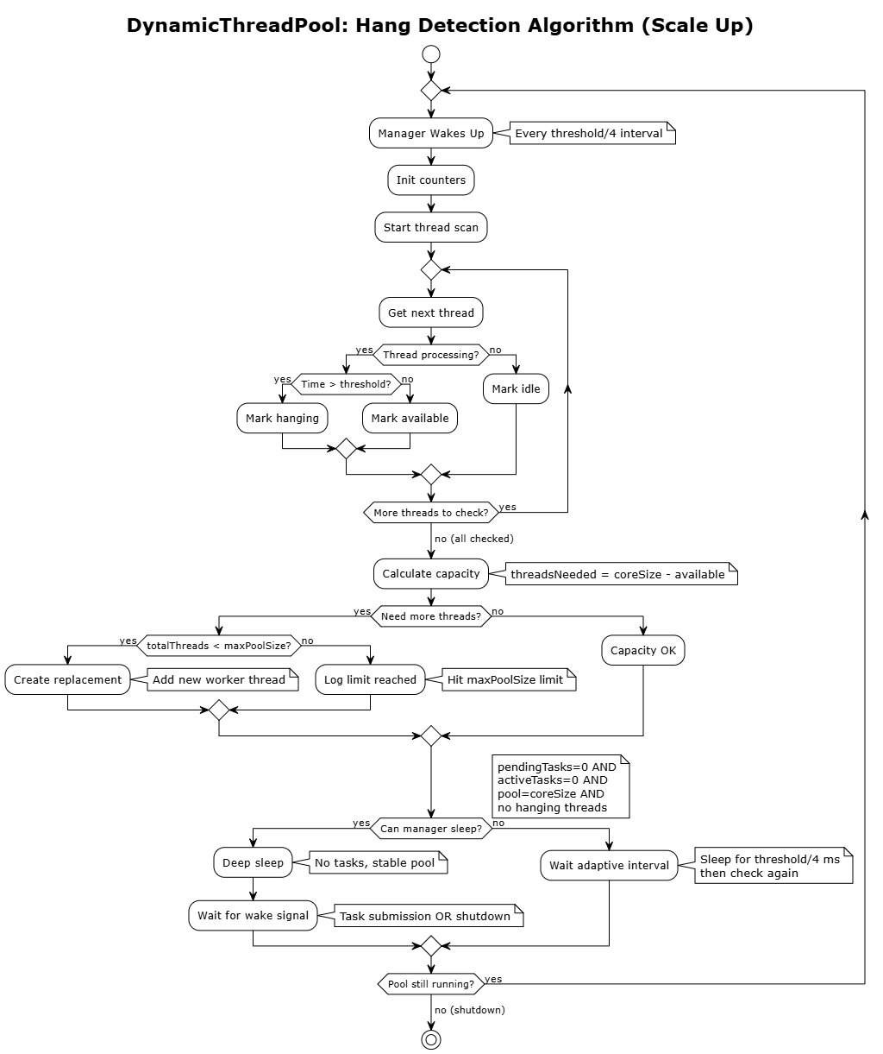
Appendix 10

Slide 38
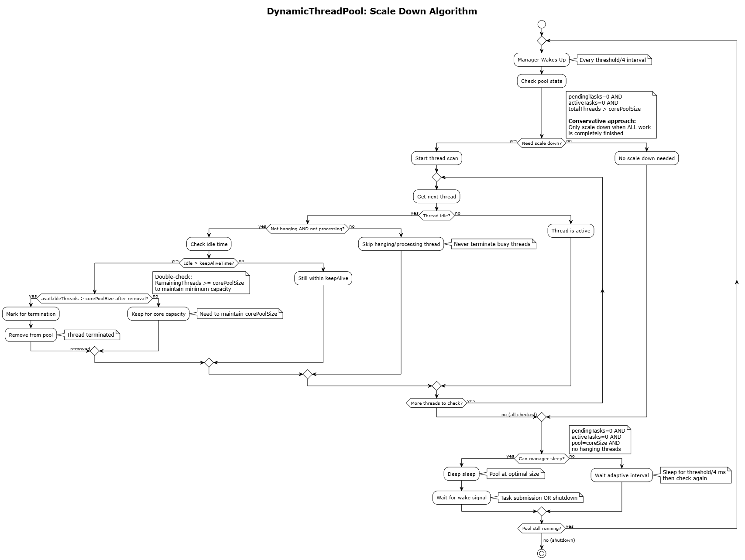
Appendix 11

Slide 39
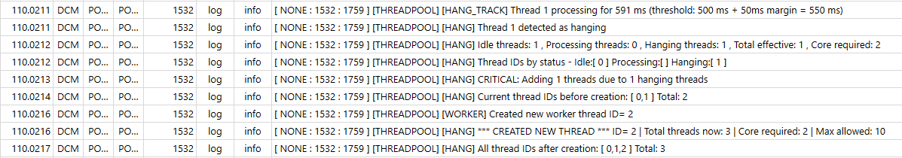
Appendix 12
Test result - Scale up:
Hanging detection triggered when thread 1 processing time reached threshold (500ms) during DiagMgr database save operation (1120ms total duration), successfully creating an additional thread. Pool automatically scaled from 2 to 3 threads (ID=2 created) to maintain system responsiveness during long-running tasks.

Slide 40
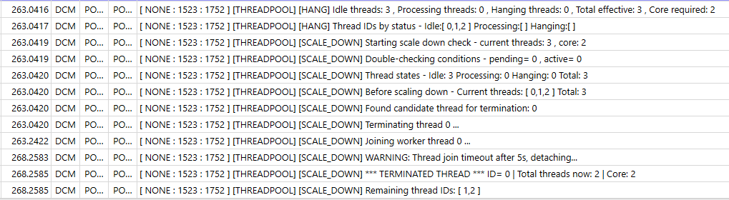
Appendix 13
Test result - Scale down:
Scale down triggered after 30 seconds idle period with no queued tasks. Thread pool detected excess threads (3 active vs. 2 core required) and gracefully terminated thread ID=0, successfully scaling from 3 to 2 threads to optimize resources while maintaining baseline responsiveness.

